Slide 1
Internship Review
5G Testbed - IITM
Hemanth
CED16I024

Slide 2
Overview
5G NR is a new air interface being developed for 5G. 5G NR stands for 5th generation New Radio. It is a new Radio Access Technology(RAT), the wireless standard that will become the foundation for the next generation of mobile networks. The standards for 5G NR are developed by 3GPP organization.
5G is next big evolution of telecom network from it’s previous technologies of LTE, GSM. 5G is named as 5G unlike 4G aka LTE, or 2G aka GSM. 5G claims to offer high throughput with low latency and increased number of connected devices

Slide 3
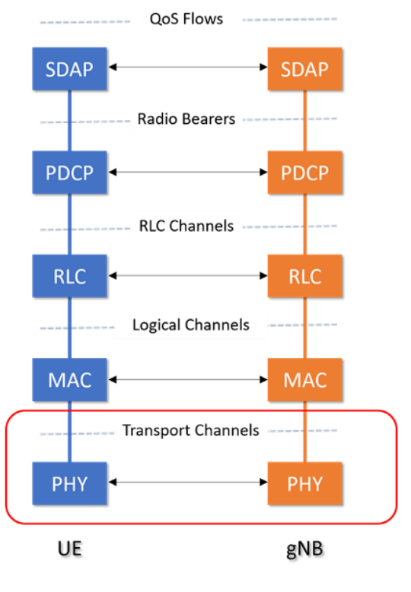
5G Protocol Stack
5G protocol stack consists of many different individual protocols. Protocols can be simply described as set of rules that allow communication between corresponding entities. 5G Protocol Stack is divided into many layers and sublayers.
MAC is one of the sub-layers.

Slide 4
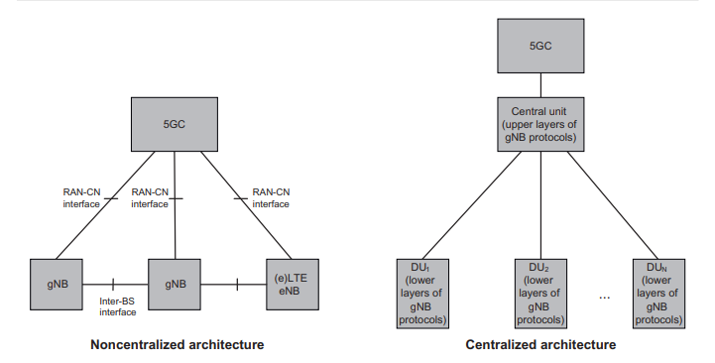
5G Architecture
The new 5G RAN architecture, as shown, supports both Non-centralized RAN architecture and Centralized RAN architecture in order to enable diverse use cases.

Slide 5
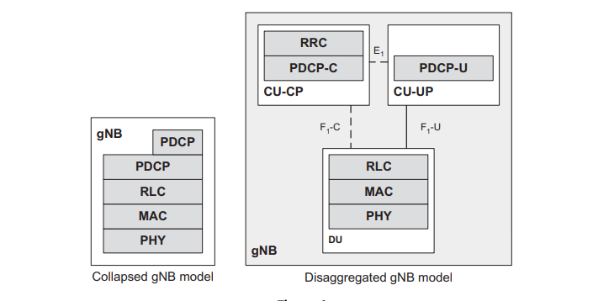
5G Deployment
Again, there are two different types of deployment scenarios:
Collapsed gNB deployment
Disaggregated gNB deployment

Slide 6
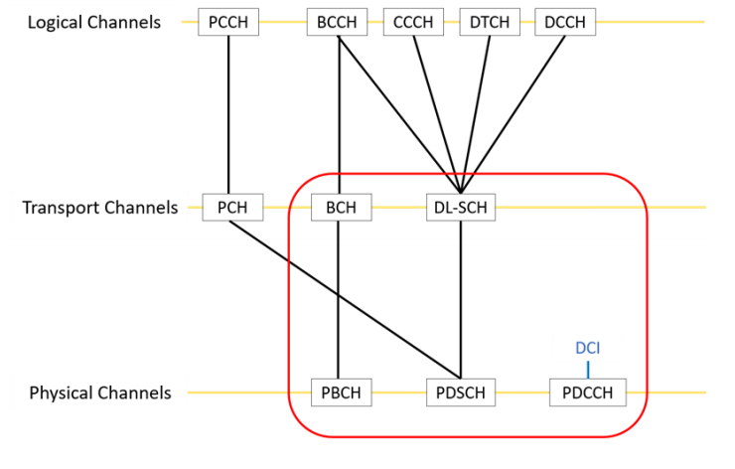
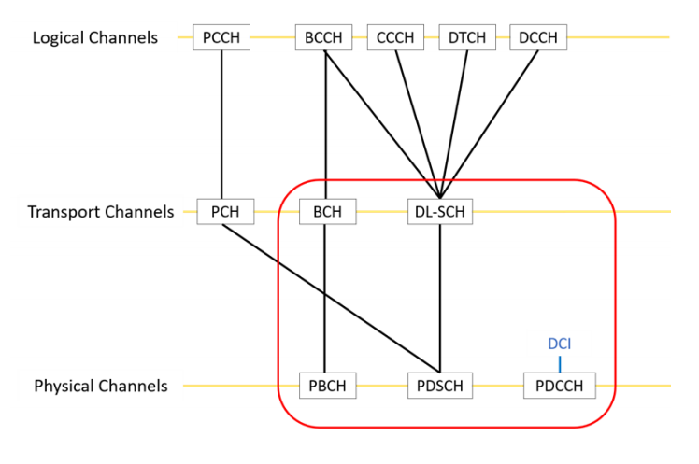
Data flow in 5G NR Protocol Stack
The data flows between UE and gNB. If the data flows from UE to gNB it is called uplink,and viceversa is known as downlink.
Data received by Nth layer from N+1th or N-1th layer is called Service Data Unit(SDU). This Nth layer will modify the data by performing required operations on the data and convert it into a Protocol Data Unit(PDU).

Slide 7
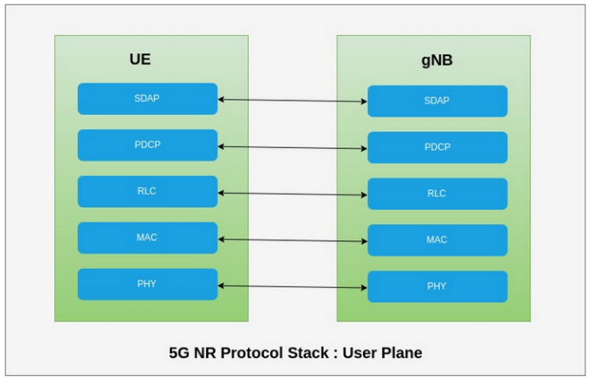
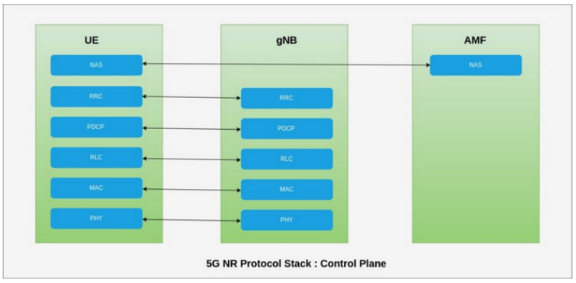
Planes in 5G NR Protocol Stack
5G NR Protocol Stack has two types planes based on the type of information it is transmitting.
1)User plane protocols implement actual PDU Session service which carries user data through the access stratum.
2)Control plane protocols control PDU Sessions and connection between UE and the network from various aspects which includes requesting the service, controlling different transmission resources, handover etc.

Slide 8

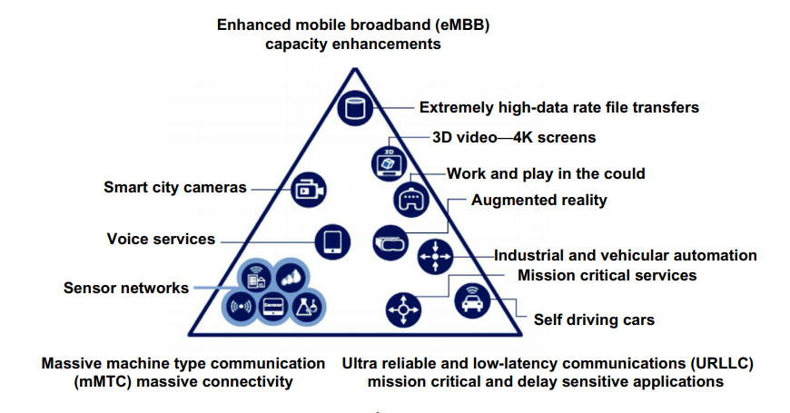
Challenges and Use cases
The key challenge in the design and deployment of 5G systems is not only about the development of a new radio interface(s) but also about the coordinated operation in a highly heterogeneous environment characterized by the existence of multi-RAT systems, multi-layer networks, multi-mode devices, and diverse user interactions.
The breakthroughs in 5G network design are expected to sustain the extensive growth and enhancement of mobile Internet and the IoT services. The use of 5G technologies in the IoT and vertical industries are providing new business opportunities for network operators.

Slide 9
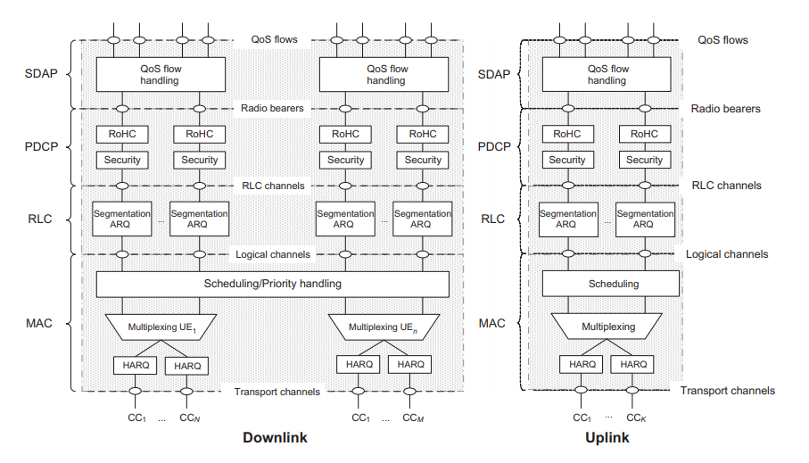
Medium Access Control Sublayer
The MAC sublayer performs logical channel multiplexing and controls HARQ retransmissions.
It also handles scheduling functions and is responsible for multiplexing/demultiplexing data packets across multiple component carriers when carrier aggregation is configured.

Slide 10
Functionalities of MAC
The MAC sublayer supports the following functions:
mapping between logical channels and transport channels;
multiplexing and demultiplexing of MAC SDUs from one or different logical channels onto transport blocks (TB) to be delivered to the physical layer on transport channels;
scheduling information reporting;
error correction through HARQ;
logical channel prioritisation.

Slide 11
Uplink and Downlink of MAC
Both uplink and downlink physical layer processing of transport channels consists of the following steps as described in:
Transport block CRC attachment;
Code block segmentation and code block CRC attachment;
Channel coding;
Physical-layer hybrid-ARQ processing;
Rate matching;
Scrambling;
Modulation;
Layer mapping;
Mapping to assigned resources and antenna ports.

Slide 12
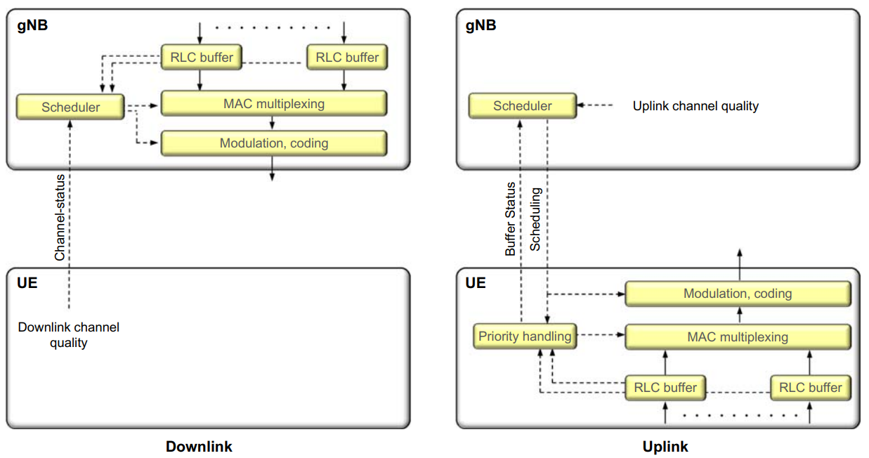
Scheduling in MAC
Scheduling is the process of allocating resources for transmitting data.
Dynamic downlink scheduling: In NR, the downlink scheduler is responsible for dynamically controlling the device(s) to transmit to.
Dynamic uplink scheduling: The general downlink scheduling discussion is applicable to the uplink as well. However, there are some fundamental differences between the two. For example, the uplink power resource is distributed among the devices, while in the downlink the power resource is centralized within the base station.

Slide 13
Hybrid ARQ in MAC
The hybrid-ARQ protocol is the primary way of handling retransmissions in NR. In case of an erroneously received packet, a retransmission is requested.
Downlink Hybrid-ARQ: In the downlink, retransmissions are scheduled in the same way as new data that is, they may occur at any time and at an arbitrary frequency location within the downlink cell bandwidth.
Dynamic uplink scheduling: The uplink uses the same asynchronous hybrid-ARQ protocol as the downlink. To differentiate between new transmissions and retransmissions of data, the new-data indicator is used.

Slide 14
Objectives of work and Motivation
Implementation of efficient scheduling algorithm for 5G MAC Sublayer.
Implementation of Hybrid-ARQ for retransmission in 5G MAC Sublayer.
Motivation:
Low Latency and high Throughput are required to acquire enhanced mobile broadband (eMBB) where users can experience a minimum of 50-100 Mbps everywhere and see peak speeds greater than 10 Gbps with a service latency of less than 1ms while moving at more than 300 miles per hour.
5G means:
Low Latency
High Throughput

Slide 15
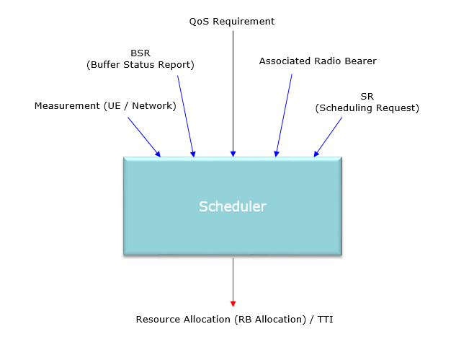
Work done on MAC scheduler
Scheduler for MAC is developed using ’C++’ programming. The structures required for the MAC are provided in the 3GPP TS 38.321 V15.8.0.
At high level view, NR Scheduling is not much different from LTE scheduling in terms of overall concept.

Slide 16
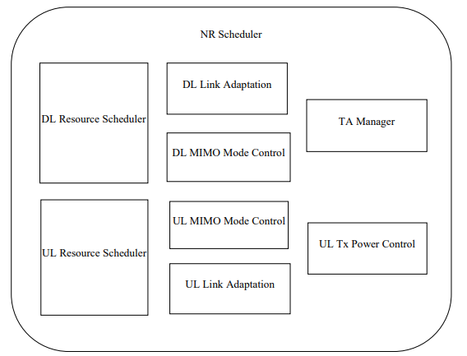
MAC scheduler components
It is assumed that the DU includes 40 complete MAC and scheduler functions implemented in the same physical platform.
NR Scheduler functional block has been further expanded into indicative smaller functional sub-blocks to capture the scheduler functionality:
DL/UL Resource Scheduler
DL/UL Link Adaptation (LA)
UL Tx Power Control
DL/UL MIMO Mode Control
TA Manager

Slide 17
MAC scheduler operations
Taking into account the UE buffer status and the QoS requirements of each UE and associated radio bearers, schedulers assign resources between UEs
Schedulers assign resources taking account the radio conditions at the UE identified through measurements made at the gNB and/or reported by the UE
Schedulers assign radio resources in a unit of slot (e.g. one mini-slot, one slot, or multiple slots)
Resource assignment consists of radio resources (resource blocks)
Implementation of Scheduler in MAC with above components and operations is achieved

Slide 18
Work done on Hybrid ARQ
Two different types of Codebook determination algorithms called Type 1 and Type 2 are implemented.
Each of these types are again divided into cases depending on whether the HARQ ACK is reported in PUCCH (Physical Uplink Control Channel) or PUSCH (Physical Uplink Shared Channel).

Slide 19
Conditional cases in Hybrid ARQ
In NR, this kind of simple method is used for a specific settings, but there are various other cases.
• < Case 1 >: Condition : PDSCH is received without corresponding PDCCH or PDCCH indcating a PDSCH release
-> Number of HARQ Bit : 1 bit
• < Case 2 > : Condition : PDSCH-CodeblockGroupTransmission = Not Configured AND PDSCH
-> Number of HARQ Bit : 1 bit per TB (Transport Block)
• < Case 3 > : Condition : PDSCH with DCI 1 0 or PDSCH
-> Number of HARQ Bits : HARQ Ack only for the PDSCH or only for the SPS
(Same cases for Uplink HarQ)

Slide 20
Tracing in Hybrid ARQ
Implementation of Hybrid ARQ is achieved using above cases.
Sequences of Harq were traced on a tracing tool and report was sent to our guide.

Slide 21
Internship timeline
MAY
JUN
JUL
AUG
SEP
OCT
Training
Understanding
Training
Implementation
Implementation
Code Review
Socket Programming, File System Internals, System Calls, and Git basics provided by Zilogic Systems
Understood the 3GPP standard TS 38.321 V15.8.0: "NR;Medium Access Control (MAC) protocol specification" and thereafter made this presentation on Chapter 6 in Dalhman, Erik's 5G NR
Training in the course of Implementation of MAC. Our main task is to design the scheduling for MAC along with Hybrid ARQ
We worked on several scheduling algorithms and finalised the best suitable one. We reported the performance of all algorithms.
We worked on implementing Hybrid ARQ. We developed simulations and tested the working of Hybrid ARQ.
Our code was reviewed and accepted. We prepared documentation for further implementations.

Slide 22
Thank you!

